Slide 1
Employee management system
S19B23/194

Slide 2
System requirement
Non-Functional requirements
check In,
checkout,
schedule,
assign work and others.
Functional requirements
logs in
views all the activities for all the users
schedules work for all the users
confirms the employee with finished work
registers new employees
resets passwords for the users
can draw reports from the

Slide 3
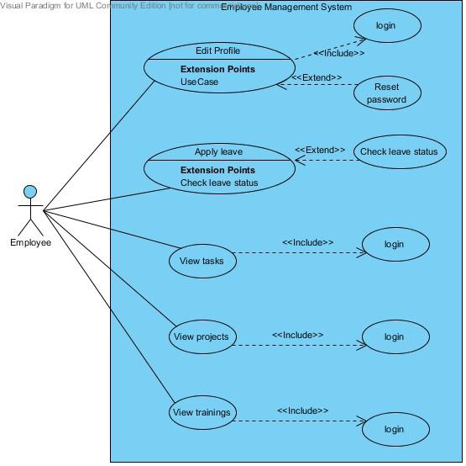
User case diagram

Slide 4
Inheritence
@Repository
public interface EmployeeRepository extends JpaRepository<Employee, Long>{
}
EmployeeRepository is the child class and JpaRepository is the parent class
encapssulation
private Long id;
private String name;
In the Role, employee and user class

Slide 5
Abstraction
@Repository
public interface EmployeeRepository extends JpaRepository<Employee, Long>{
}
EmployeeRepository is implemented using interfaces so examples EmployeeRepository
polymorphism
findById(id)
findAll()
For finding an employee

Slide 6
Class diagram
User
User ID
Username
Password
first Name
last Name
Users’ role
login
Update details
Class diagram is a picture of the classes, their fields, methods, and connections between the classes that interact or inherit from each other
In the below class diagram, the Employee and Admin classes inherit from the User class.
The employee class is also parent class to Human Resource class, Head of Department class and Ordinary employee class.
An ordinary employee may include supply chain and procurement officers, accountants and all other employees that do not interact with the system with many privileges. These employees carry out the same operations.
Admin
registration ()
search ()
activity log ()
add user ()
send email ()
Employee
Department
Name
Pfno
Email
Location
Nationality
Home Area
Duties
AcademicDetails
EmploymentHistory
nextofKin&Dependants
login
leaveapply()
leavestatus()
updatedetails()
projects()
trainings()
techskills()
viewemails()
=
Human Resource
search()
generatereports()
leave()
sendemail()
Head of Department
search ()
assigntasks ()
viewtrainings ()

Slide 7
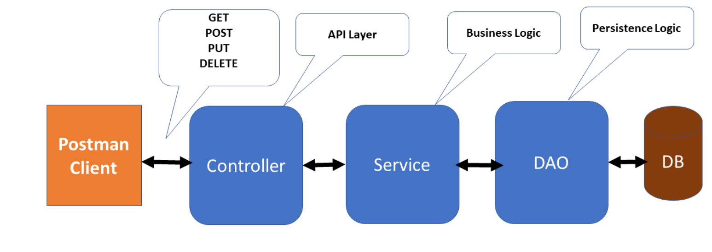
ARCHITECTURE
Model view controller
Model employee
View using the API(Application Programing Interface) to display on the front end (html,css,js)
Controller
@Controller
public class EmployeeController {
@Controller
@RequestMapping("/registration")
public class UserRegistrationController {
Notes:
In the case of the employee management system for the implementation of the architecture it’s in the services

Slide 8
Code refractory
public String deleteEmployeeById(Long id) {
Optional<Employee> toDelete = id != null ? employeeRepository.findById(id) : Optional.empty();
if(toDelete.isPresent()) {
employeeRepository.delete(toDelete.get());
}
//this.employeeRepository.deleteById(id);
return "deleted";
}
The comment above was removed and replaced with uncommented code.

Slide 9
TESTING
This phase determine the error in the project. If there is any error then it must be removed before delivery of the project.
For determining errors various types of test action are performed.
Unit Testing: -
Unit testing focuses verification effort on the smallest unit of software design – the module.
System Testing: -
Software is only one element of a larger computer based system. Ultimately, software is incorporated with other system elements (e.g. new hardware, information), and a series of system integration and validation tests are conducted.

